Slide 1

Capstone Two Final Presentation
Godwin Omowele | July 2025
NBA Salary Value Model

Slide 2

Agenda
Problem Statement & Use Case
Data Sources
EDA – Salary Skew
Feature Selection
Modeling Pipeline
Results & Metrics
Key Drivers & Model Fit
Conclusion & Next Steps

Slide 3

Problem & Use Case
Predict fair 2024‑25 salary from 2023‑24 performance metrics.
Help GMs identify over‑ and under‑valued contracts.

Slide 4
Who Cares?
NBA GMs & Salary-cap managers
Player agents & athletes
Data-driven media & fans

Slide 5
Basketball-Reference: stats
HoopsHype & Spotrac: salaries
Data Sources

Slide 6
Merged on Player name
Cleaned currency, formatted Salary
Dropped duplicates/unneeded cols
Wrangling Steps

Slide 7
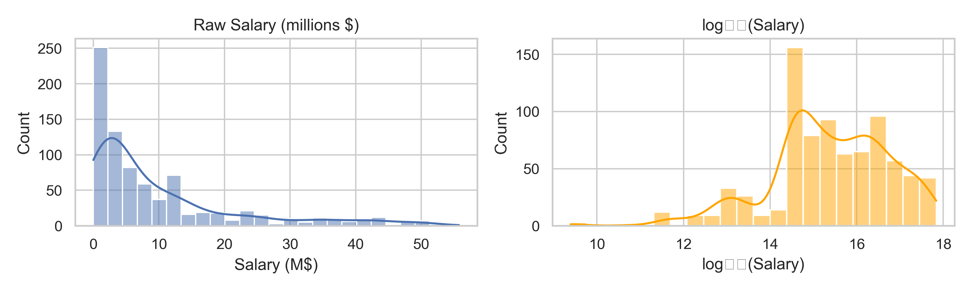
EDA – Salary Skew

Slide 8
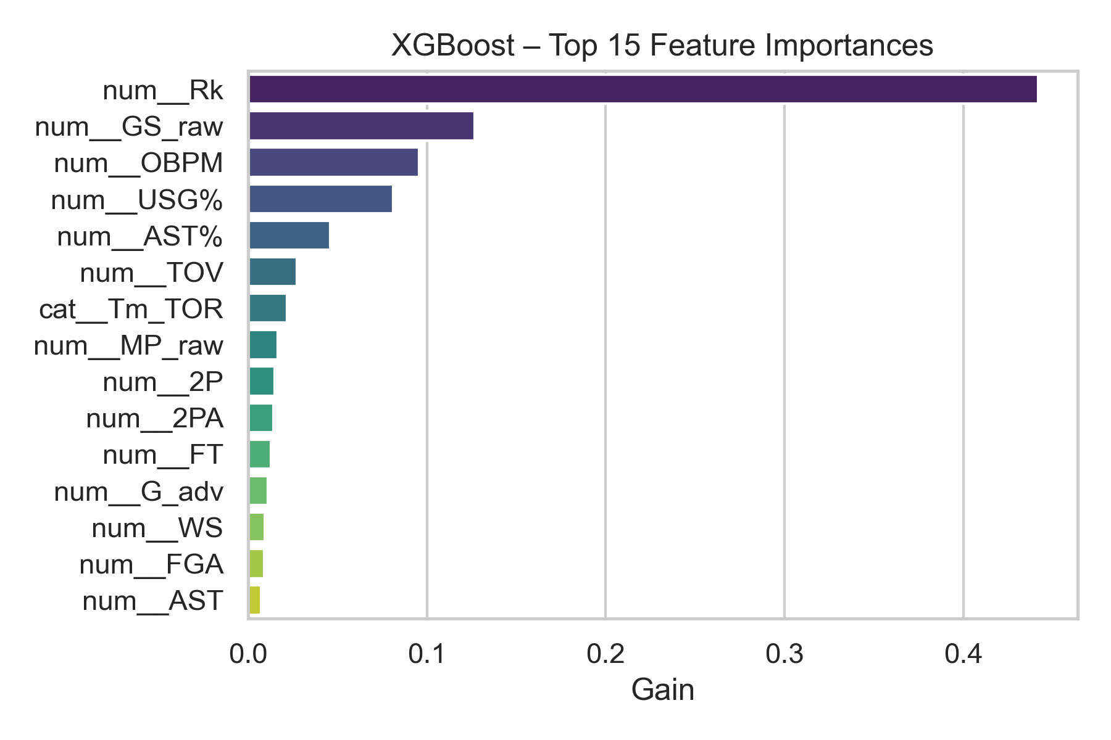
Selectkbest (k=40) – top production metrics

Slide 9
Modeling Pipeline
Preprocess: median‑impute + StandardScaler + OneHot
SelectKBest (40 best features)
Models: Linear, Random Forest, XGBoost
Targets: raw Salary and log₁₊(Salary)

Slide 10
Raw Target
-Linear: Test RMSE $6.68 M, R² 0.62
-Random Forest: Test RMSE $2.41 M, R² 0.95 -XGBoost: Test RMSE $2.48 M, R² 0.95

Slide 11
• XGBoost (log): Test RMSE $0.50 M, R² 0.92
• Random Forest (log): RMSE $0.56 M, R² 0.91
• Linear (log): RMSE $0.95 M, R² 0.79
LOG TARGET

Slide 12
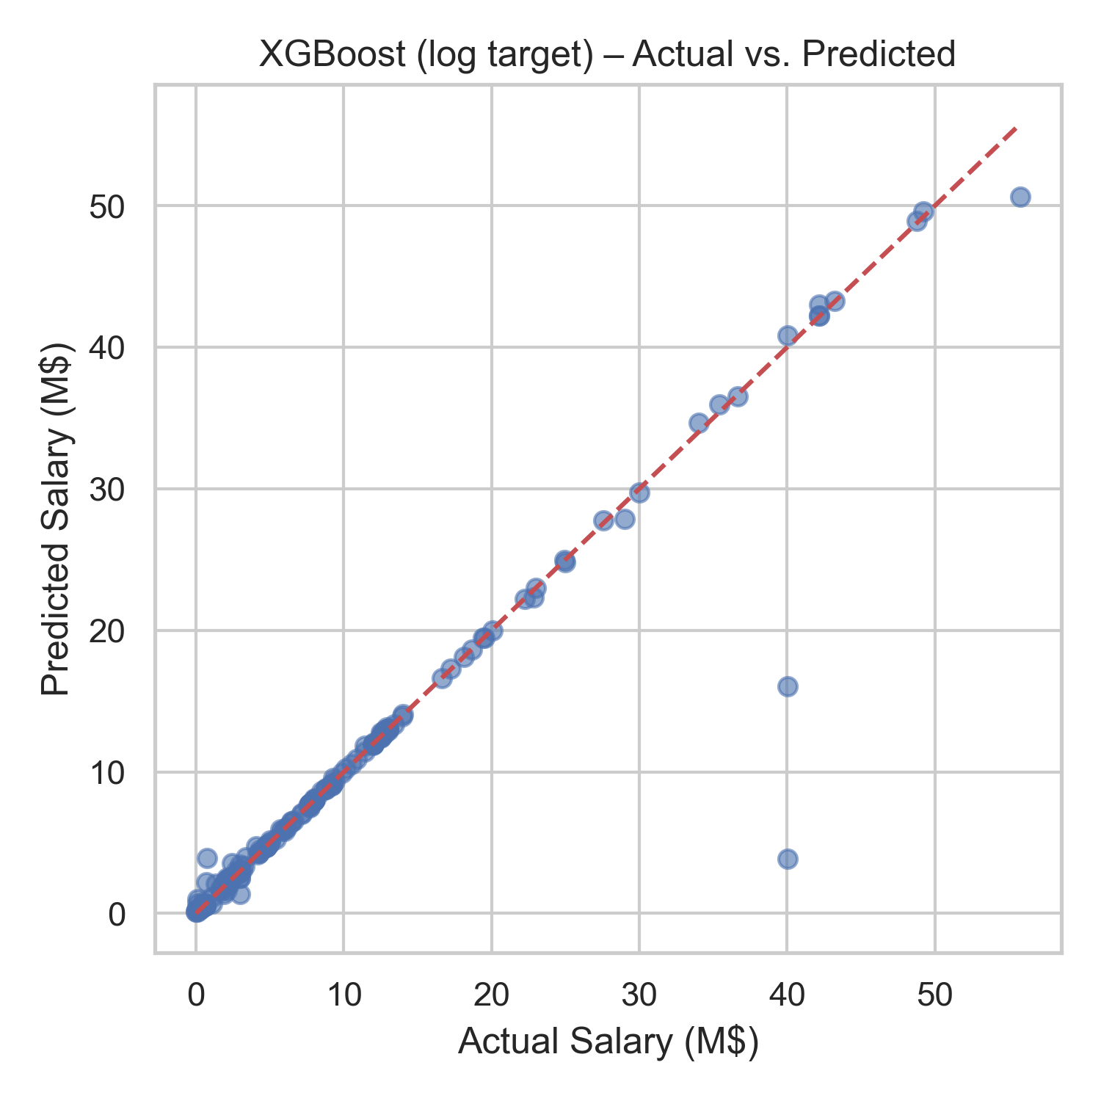
Model Fit Quality

Slide 13
Created ‘Value per Dollar’ = key metrics ÷ salary
Ranked players by this value index
Feature Engineering

Slide 14
One-hot encode categoricals
Median-impute missings
StandardScale numerics
Train/test split: 75%/25%, random_state=42
Preprocessing Steps

Slide 15
Single-season only
Excludes playoffs & injuries
Name merge may miss players
Future: multi-season & incentives
Assumptions & Limitations

Slide 16

Conclusions
XGBoost + log₁₊ target → Test RMSE $0.50 M (≈ 4 % of avg salary) and R² 0.92
Errors small enough for contract-level decisions.
Identifies \$4 M bargains and \$28 M over‑pays.

Slide 17

Next Steps
SHAP explanations for per‑player transparency.
Add playoff & injury variables.
Deploy model in a salary‑valuation dashboard.

Slide 18

Questions & Feedback
Thank you! I welcome your questions and feedback.

